Slide 1
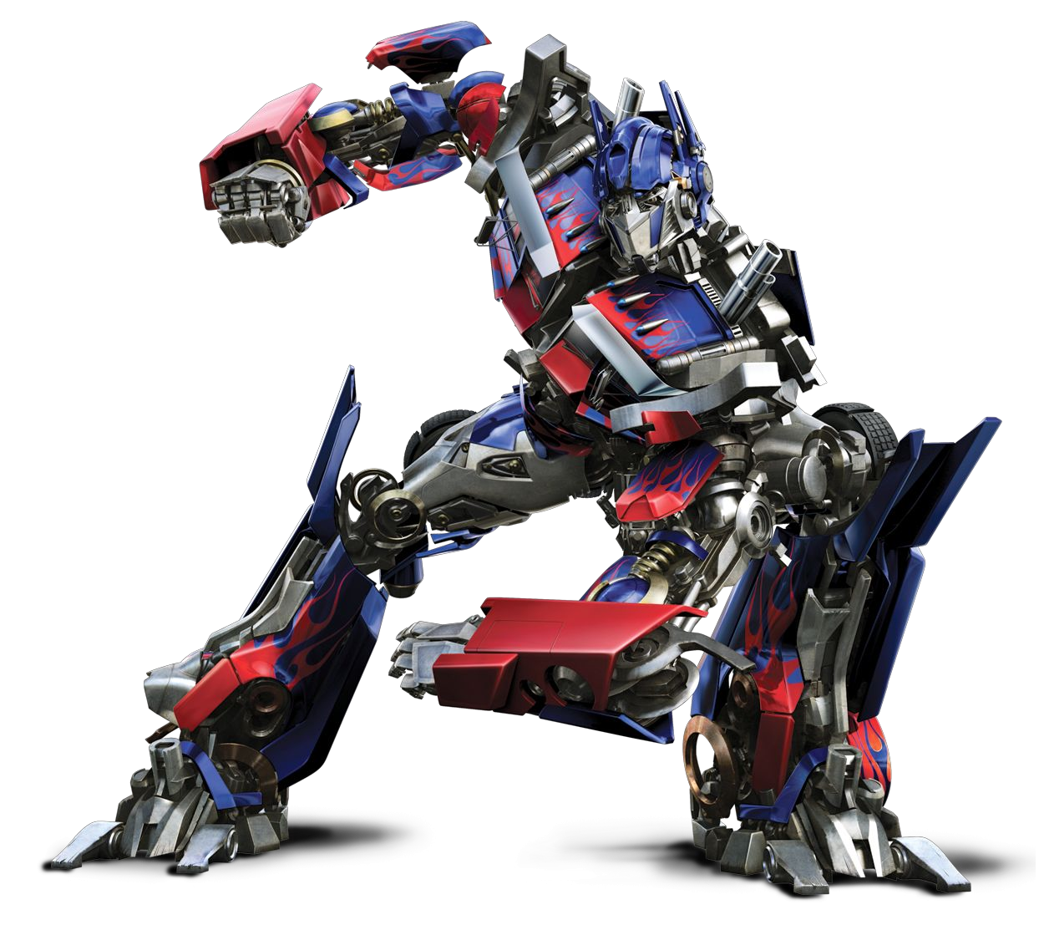
Transformers
Agenda
- Understand the architecture of transformers
- Understand the attention mechanism
- Implement your transformer from scratch
Harmya Bhatt

Slide 2
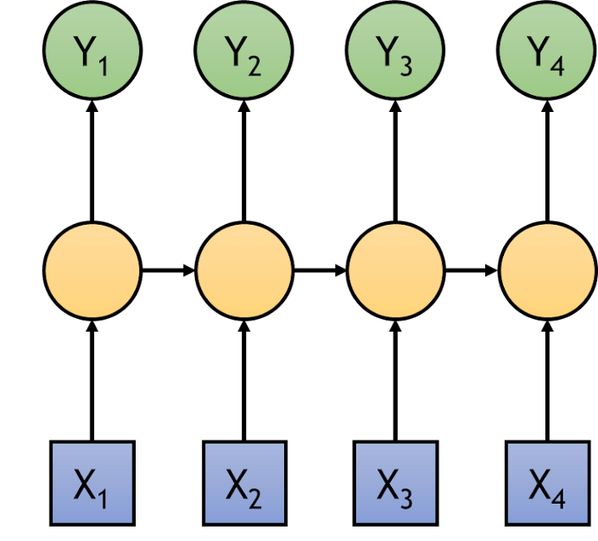
Motivation
We like RNNs (Recurrent Neural Networks), but:
Slow computation, because we generate an output Yi and a hidden state for each input token Xi
Vanishing Gradient Problem: For a complex RNN, the gradient of the cost function with respect to weights deeper in the model gets very small.
Each orange node is a hidden state

Slide 3
Word Embeddings
Word embeddings convert words into numerical vectors
Embeddings compress the vast information of words into a dimensional space, making it easier for models to learn patterns and similarities between words

Slide 4


Slide 5
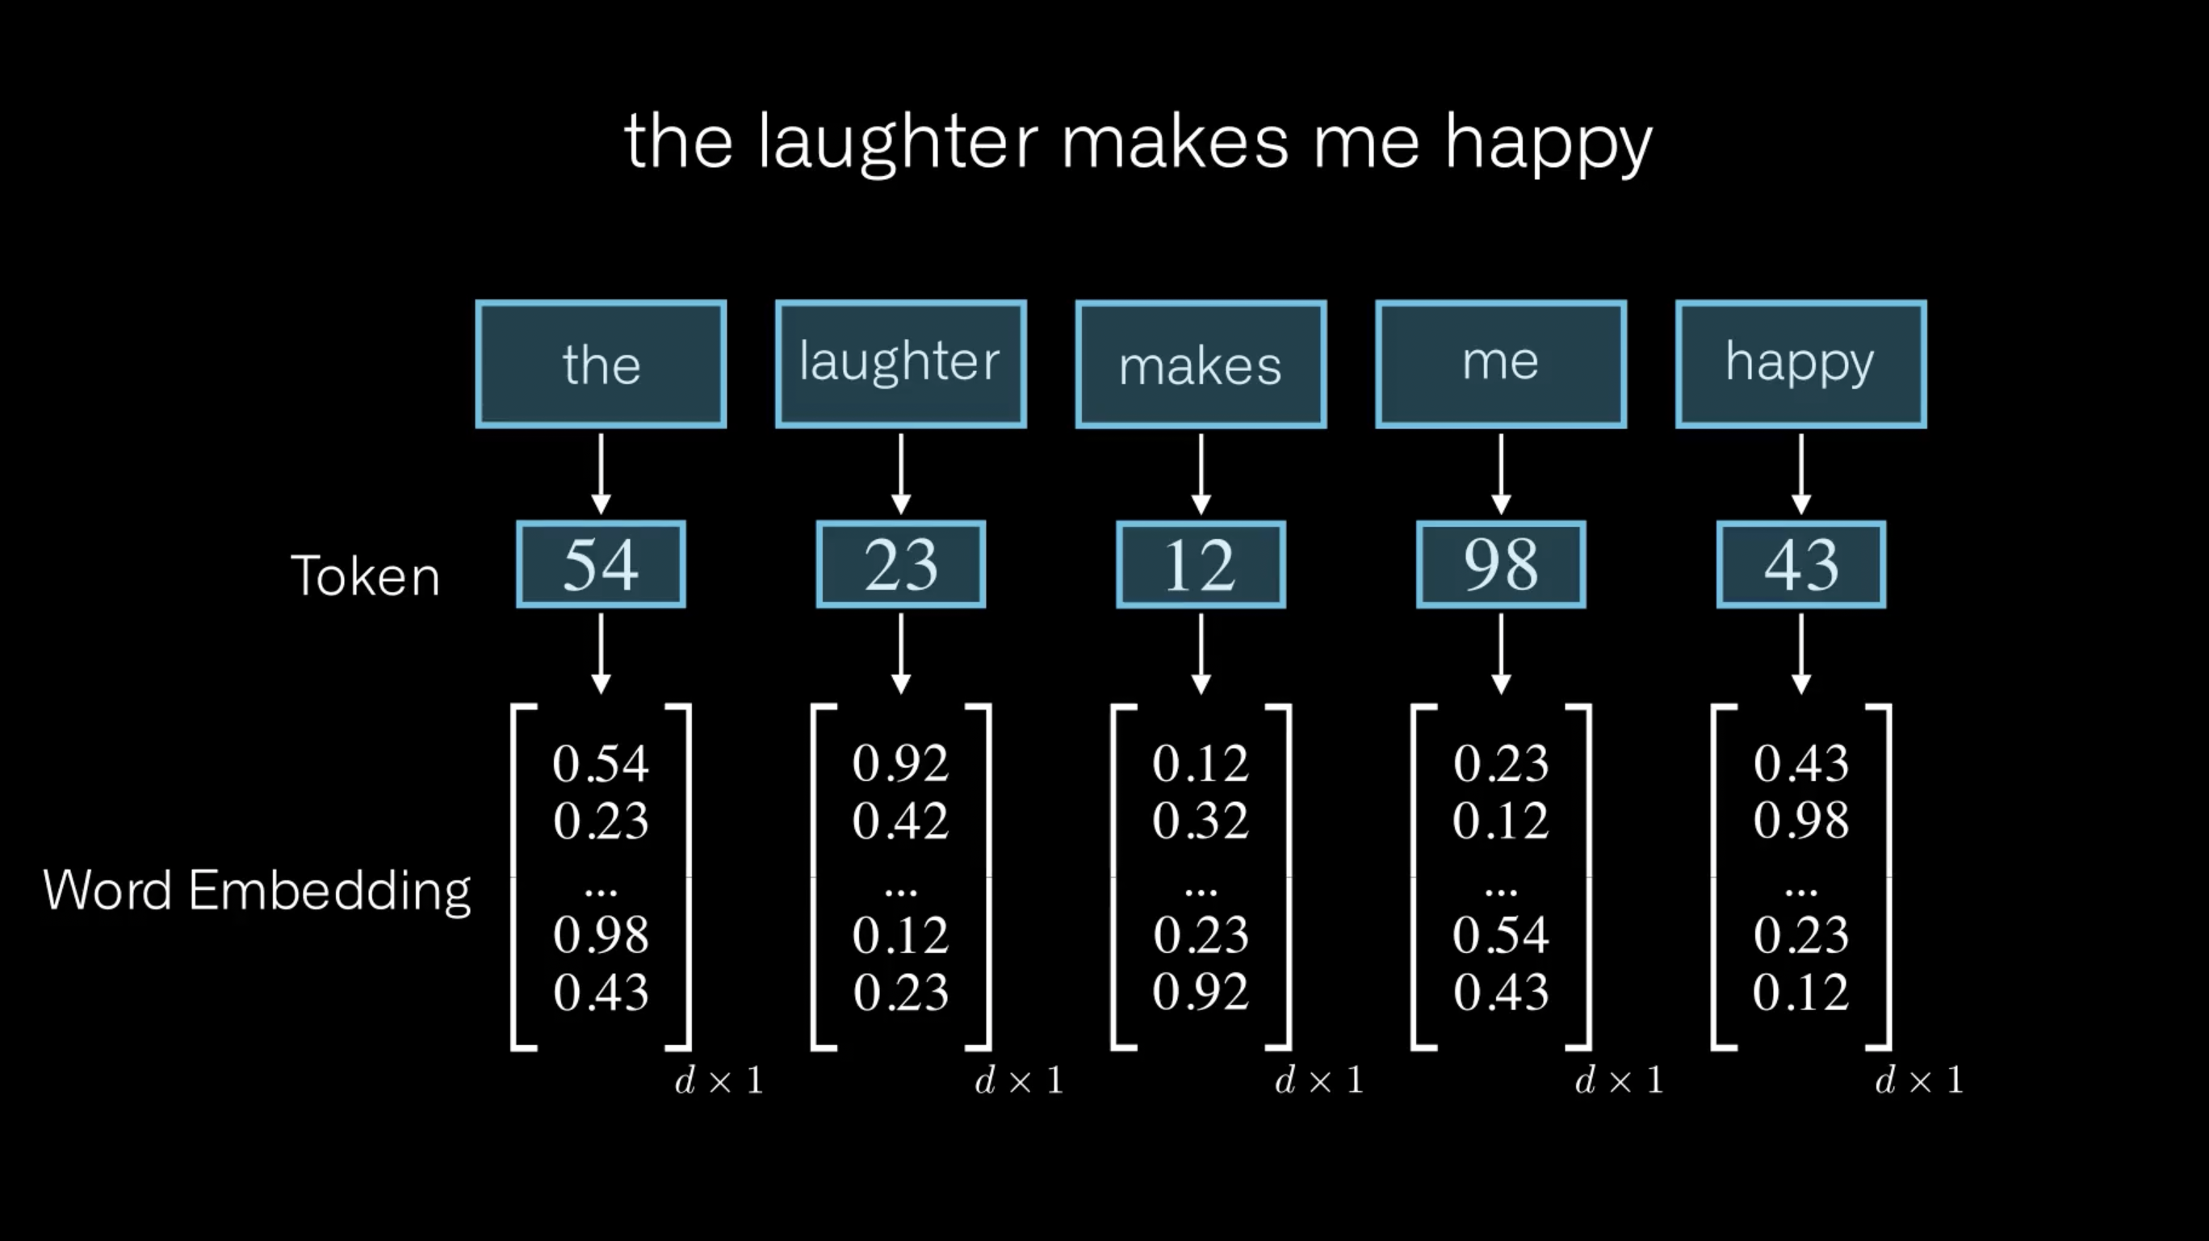

Slide 6
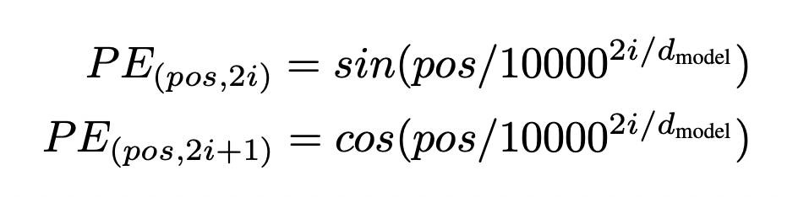
Positional Encodings
We want each word to carry some information about its position in the sentence.
We want the model to treat words that appear close to each other as "close" and words that are distant as "distant".

Slide 8
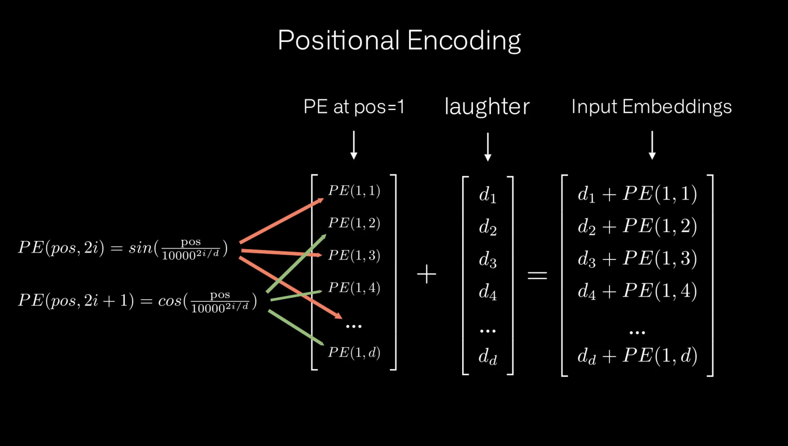

Slide 9
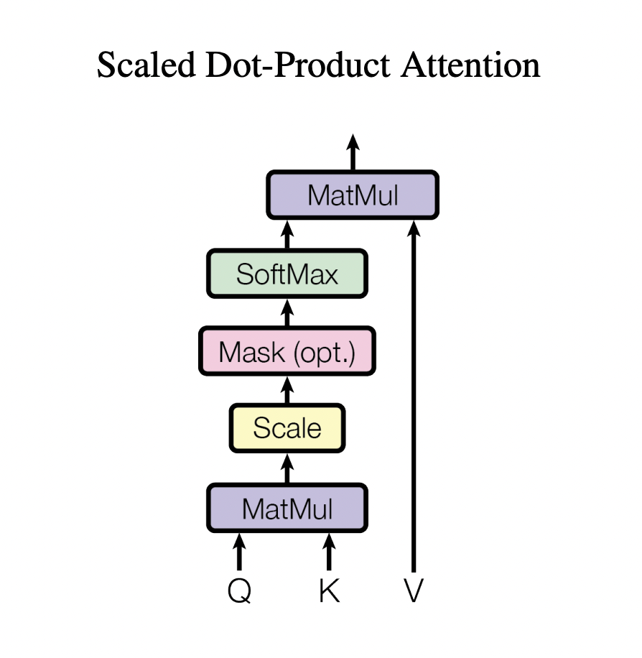
Attention
Attention mechanisms allow the model to focus on relevant parts of the input sequentially.
The model assigns weights to different parts of the input, indicating how much focus should be given to each part when predicting a word or processing a sequence.
Attention provides context by dynamically considering the entire input sequence and its parts, enabling the model to make more informed and accurate predictions or decisions.

Slide 12
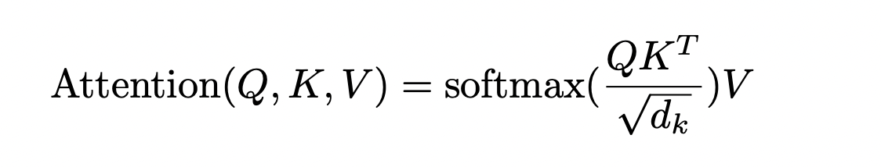
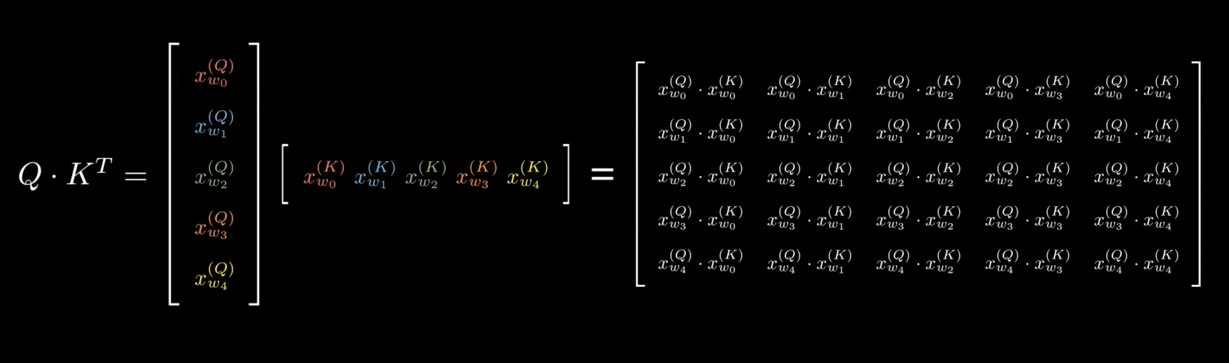
Attention

Slide 14
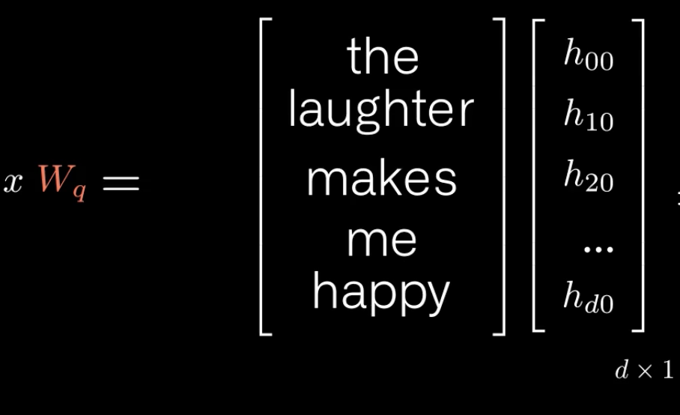
Remember This?
Single Head Attention

Slide 15
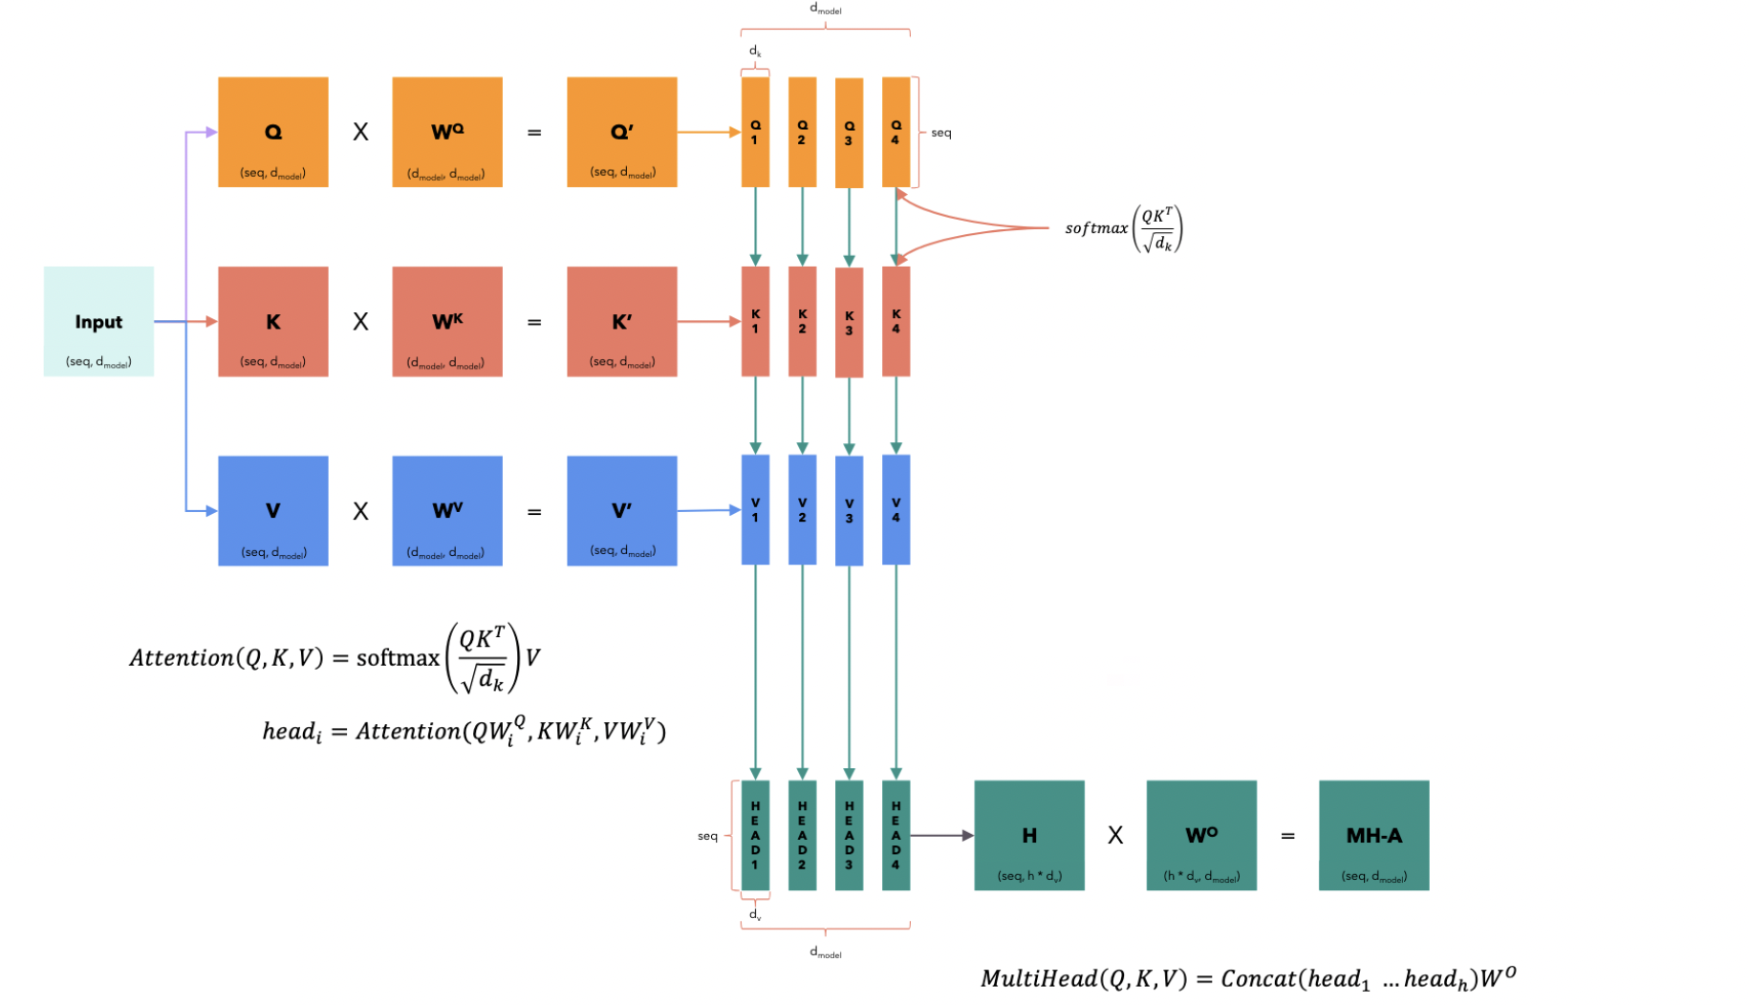
Multi Head Attention

Slide 16
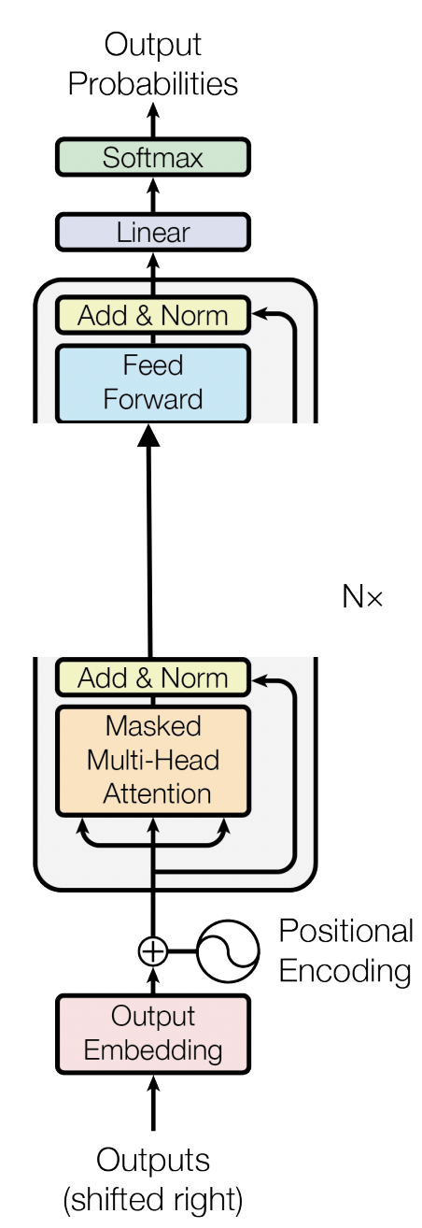
Decoder Architecture
No cross attention because no encoder

